Slide 1
Knitting Together Qualitative and Quantitative Data About Your E-journals
Evaluating the quality of your most highly-used ejournals
Karen R. Harker, MLS, MPH
Chris Hergert
UNT Libraries Collection Assessment Unit
Notes:
Thank you for attending this session. I am Karen Harker, Collection Assessment Librarian at UNT Libraries, down the road, and this is Chris Herger, Collections Data Analyst. We will describe to you how we use data from the Clarivate Journal Citation Reports (JCR) to evaluating our journal holdings.

Slide 2
How do you evaluate journals?
Qualitative
Journal ratings
Quantitative
CPU
Usage
Impact Factor
Holdings by libraries
Notes:
When evaluating or assessing journal holdings, there are usually a couple of approaches most libraries use – namely, assessing the quality of the journals provided, and then the more quantitative metrics of usage, expenditure, holdings, and cost-per-use (CPU). Each of these have their benefits and concerns, notably…^

Slide 3
The Librarian’s Perennial Conundrum
Qualitative Measures
Quantitative Measures
Based on perceptions (of quality)
Subjective
Prone to bias
Hard to find or access
Difficult to integrate with other information
More accessible
Easier to understand and use
Perceived as being less biased
Often more relevant to meeting own users’ needs.
Notes:
Qualitative measures are inherently subjective and, thus, prone to bias. The data is also harder to access and difficult to integrate with other data.
Conversely, the quantitative measures are usually quite accessible, easier to understand and use, are perceived as being less biased, and are consider closer to measuring the ability of library to meet the user’s needs.

Slide 4
The value of comparing resources by both qualitative and quantitative measures
When comparison shopping
Which to buy?
Which to drop?
For accreditation reviews
We have 80% of the top-tier journals!
Collaborative selection with faculty
Which should be used more?
Notes:
So, this begs the question, though…why combine these measures? Well, together, they can be very useful when making selection decisions between similar resources – should we allocate our precious funds towards an obscure and unrated journal, or one that has a higher measure of external quality, especially when there is little input from faculty?
Also, making statements in accreditation reviews, claiming, for instance, that the library provides 80% of the top-tier journals in biological sciences.
Finally, often faculty protest when a highly-ranked journal is being cancelled due to poor use. This is a conversation starter towards answer the question, why aren’t the students & faculty using this resource more?

Slide 5
Sources of qualitative lists
Bibliographies
Standardized journals lists
Lists of journals indexed by key literature databases
Departmental lists of journals for tenure review
Journal Citation Reports
Notes:
While there are many sources of qualitative lists against which to compare, the one we’re going focus on today is the Journal Citation Reports (JCR), formerly published by ISI, then Thomson-Reuters and, now by Clarivate.

Slide 6
Quick look at JCR
Original source of the “Impact Factor”
Based on recent citations to recently published articles
Two-year and now, 5-year
Include other metrics, including:
# Publications
# Citations
Eigenfactor
Immediacy Index
Available by subscription only
Much debate about the utility of these metrics, but…
Assume their validity for the moment.
Notes:
Who here has heard of JCR? Well, a very quick review for those less familiar with it – the JCR is a summary tool developed from the same sources as the original citation indexes – Science Citation Index & Social Science CI. It is from this tool that the journal impact factor originates. Basically, it is measure that is calculated based on recent citations to recently published articles. Originally it was based only on 2 years, but now there is a 5-year JIF to give a journals’ longevity. Other metrics provided in the JCR include # of publications, # of citations, another measure of a journals’ influence, called the Eigenfactor, that is scaled against all journals indexed in JCR, and Immediacy Index, which focuses on the time to first citation since article’s publication.
It is available only by subscription, and it isn’t cheap. So, this solution may not be available to smaller institutions. But if it is, we hope librarians will take advantage of its availability to use it for their own purposes.
Finally, there is much debated about the validity and utility of these metrics. We don’t have time to go into these issues here, so for now, we will assume their validity.

Slide 7
Qualitative measure: Overlap with JCR
Your library’s journal holdings
JCR Journals All Categories
Your library’s journal holdings
Your library’s journal holdings
Notes:
Like most measures of external quality, the metric we derive from the JCR is one of overlap – how many journals index in JCR (all journals or just for selected subject categories) does your library provide access to? ^None? ^Some? ^A lot?

Slide 8
Comparing usage ranks with JCR ranks
Global Citation Analysis Rank (JCR)
Local Journal Usage Rank
Journal A
Journal B
Journal C
Journal D
Journal E
Journal C
Journal B
Journal A
Journal D
Notes:
Furthermore, we can compare the ranked lists of JCR and journals used at your library to answer the question, Are they “eating what’s best for them”?

Slide 9
But, isn’t this a lot of work?
Subscribe
Export
Import
Export
Import
Match
to JCR.
lists of journals by Subject Category
into Excel or Access/MySQL database.
your ejournals list.
into same Excel or database.
with own journals list
with journals usage
your journal usage lists
Notes:
OK, sounds easy, right?
NOTE: Clarivate will provide files for you for a fee. You can decide if it is worth the cost.

Slide 10
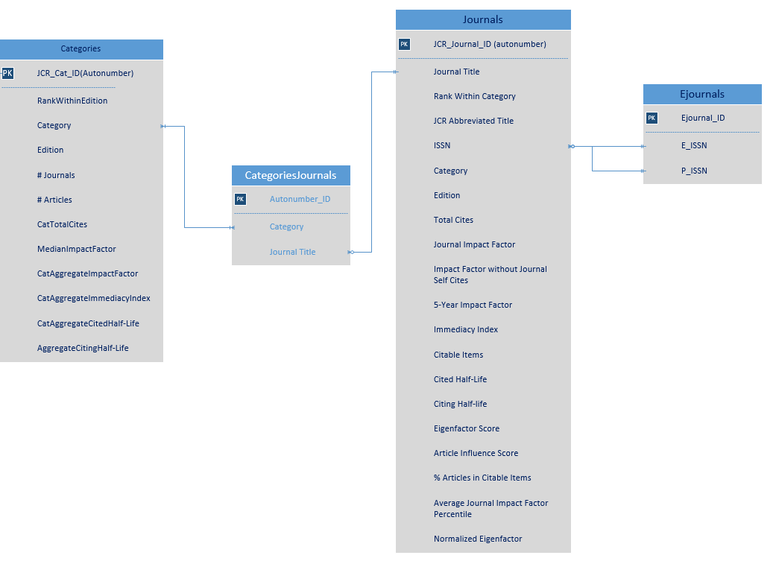
General Process for Creating JCR Database
Download Categories data and merge
Download Journals by Category and merge
Combine Journals and Categories
Create Junction table and format
Import into database
Import ejournals table
Create queries to compare ejournals holdings to JCR lists
Notes:
This is our general process that we’re going to walk through, and roughly the first half (parts 1- 4) of this will be data collection and cleaning, but the back half will be only for those of your who want to use your JCR data in an actual database.

Slide 11
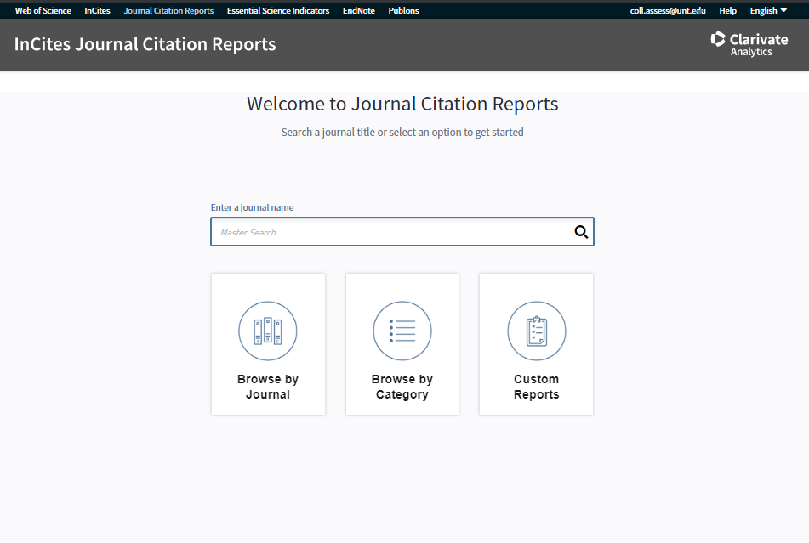
Demo exporting from JCR – Go to JCR Insights
Start from JCR Home page
Select "Browse By Category"
Notes:
Starting at the JCR homepage after logging in, click “Browse by Category”

Slide 12
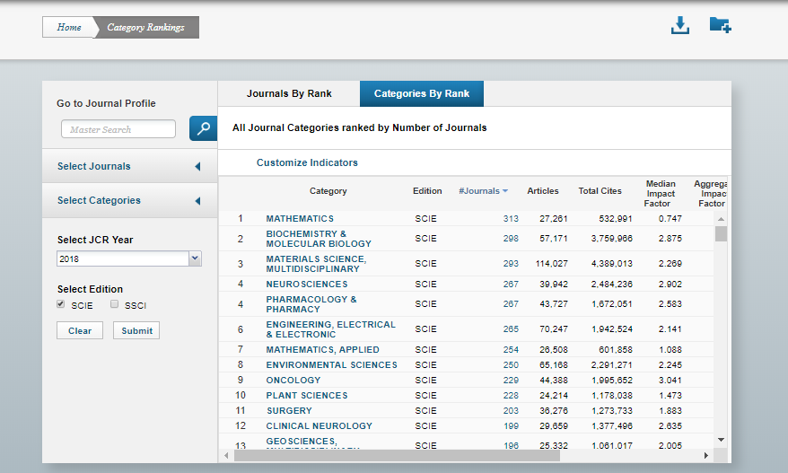
Demo exporting from JCR – Download Categories I (Configure categories)
Select the variables you'll need
Select the correct year
Select only "SCIE"
Submit
Download your data
Repeat with "SSCI" instead of "SCIE"
Notes:
To start, you select “Customize Indicators”, which will bring up a panel of check-boxes that you can use to pick which data you’d like to get for the categories.
Next, go ahead and run down the rest of the selections and hit submit, picking the right year and edition, then go ahead and click up top to download your data as a CSV.
The last thing to do is select either SSCI or SCIE, whichever you didn’t choose before, and submit again, and now you can download the complementary set of Categories

Slide 13
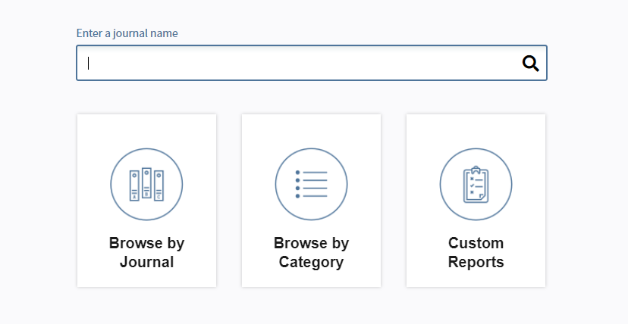
Demo exporting from JCR – Downloading All Journals Lists I
Return to the Clarivate homepage and select “Browse by Journal”
Notes:
This one’s going to be just like before, but we’re going to pick “Browse by Journal” this time.

Slide 14
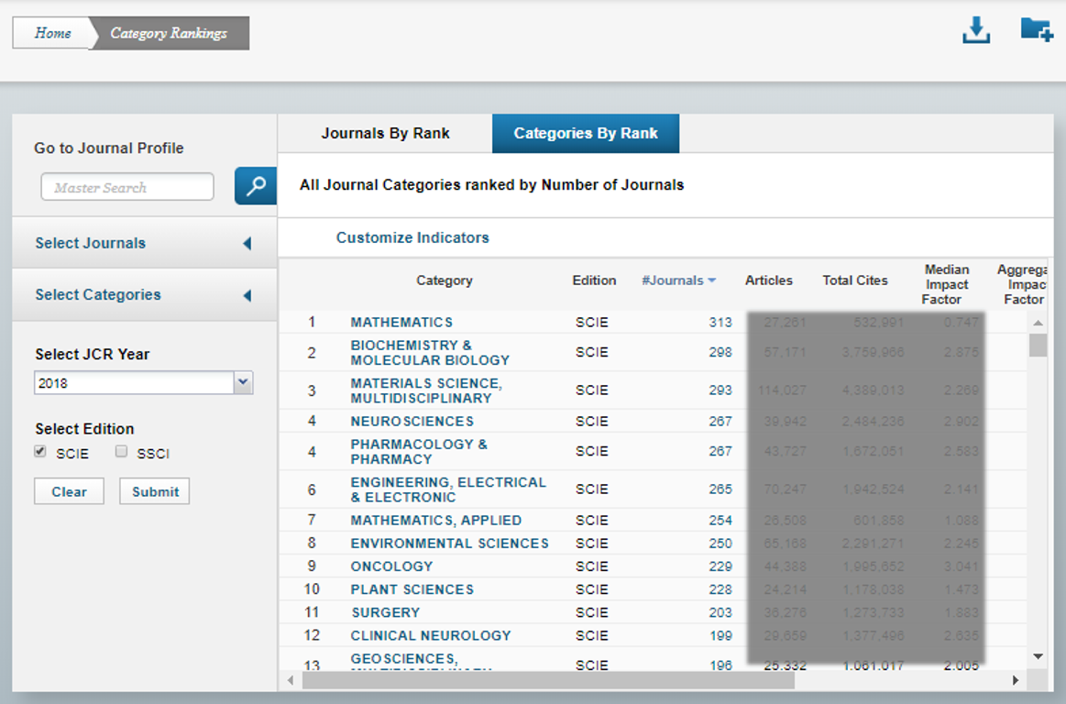
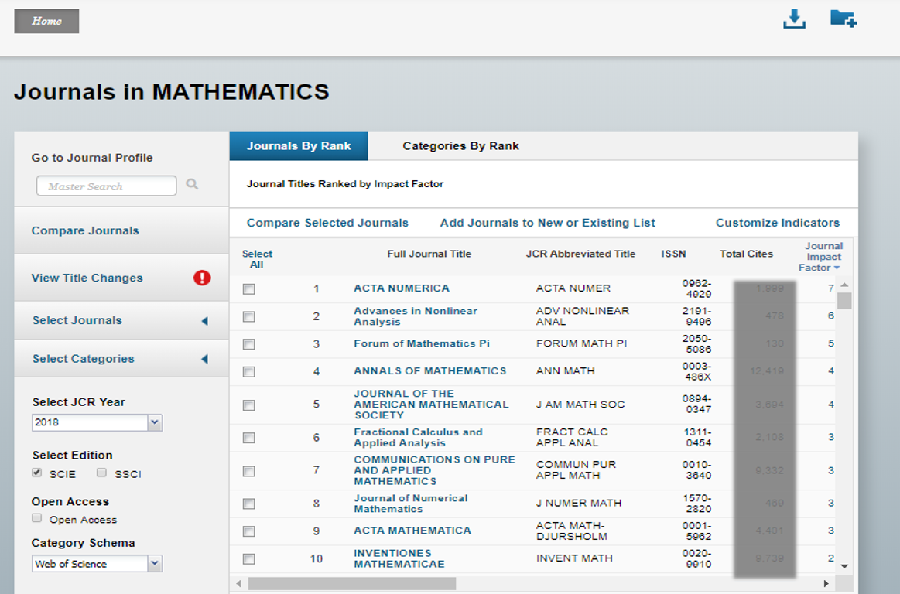
Demo exporting from JCR – Downloading All Journals Lists I
Select the correct year and only “SCIE”, then submit.
For each JCR Category, select the “#Journals” value and then download the data there.
Download journal list for every JCR Category, for both the “SCIE” and “SSCI” editions.
Notes:
This one’s just like before, go ahead and select the year of data that you want and edition, then submit. For each category in this table, you’ll need to click the link at the “#Journals” value and then download the data there just like we did with the Categories tables.

Slide 15
Formatting Data Files
For each Categories and Journals CSV files:
Delete the top row above headers (download information)
Delete the last two rows below data (copyright statement)
Wherever a category is present in both SSCI and SCIE, append “ (SSCI)” to the end of the Category name in the SSCI version.
Example:
Notes:
For both the Categories and Journals lists, each file that you download will have an extra row of download information and two rows at the bottom that aren’t useful data and impede our ability to import this data into any sort of system, so we can just delete those rows.
For any categories that are in both the SSCI and SCIE editions, append “SSCI” to the end of the category name in both the Journals list and the Categories list, as this is how we’ll differentiate between them for matching.

Slide 16
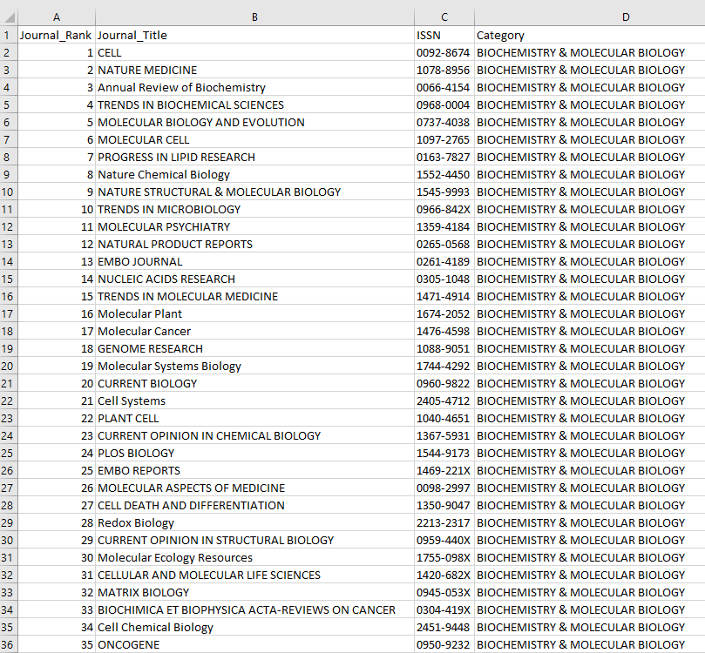
Combining Workbooks
Copy the entire combined Journals CSV file into a new tab in the Categories file, and save as a new workbook
Create a new sheet called “Junction” and copy over the Journal Name, Category, and Rank columns from the Journals sheet
Notes:
Once the CSVs have been cleaned and formatted, go ahead and append all of the journals lists into one long list, around 16-18,000 rows, and then do the same with the two categories tables. The categories should come out to just shy of 250 rows after being combined.
Create a new sheet called “Junction”, and copy over only the Journal_Rank, Journal_Title, and Category columns from the Journals sheet. You should have three tabs in your Excel workbook, now.

Slide 17
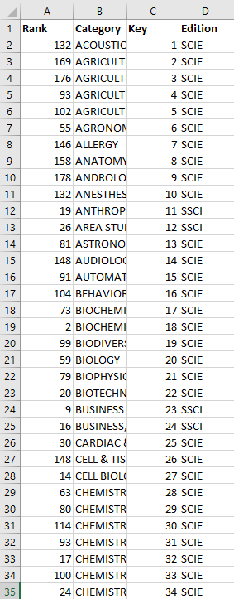
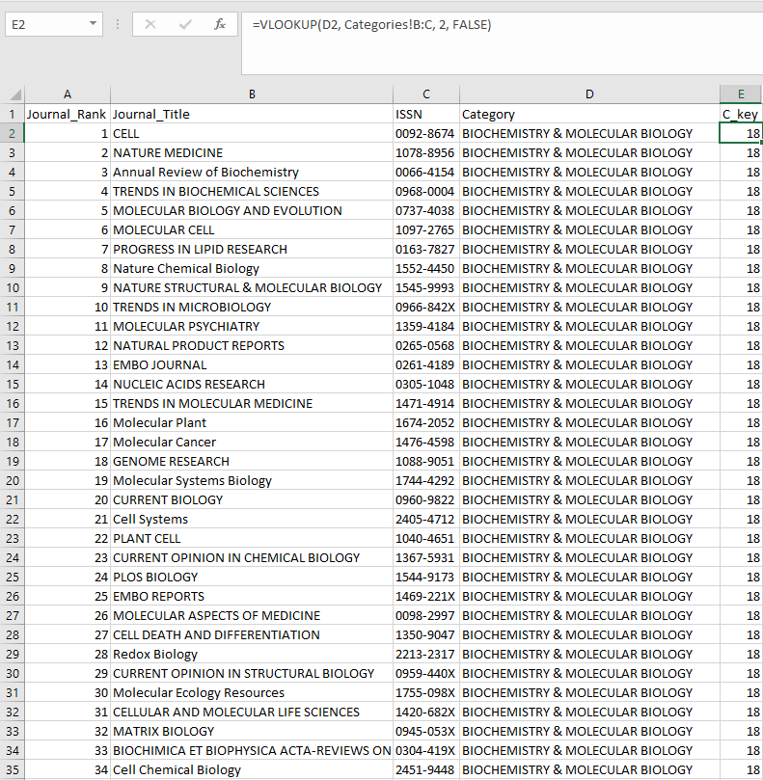
Formatting Categories table
Add an auto-numbered “Key” column to the Categories sheet
Import the keys to the Junction sheet based on each journal’s category in a “C_Key” column
1.
2.
1. Auto-numbered keys on Categories table
2. Category keys imported to Junction sheet
Notes:
This is where we jump into formatting these tables for use in a database.
For the Journals table, add a key column and populate it with sequential, non-repeating numbers starting at 1
In the Junction table, add a column called “C_Key” and import that category’s key value based on the Category column. This can be done with an Index-Match or a VLOOKUP.

Slide 18
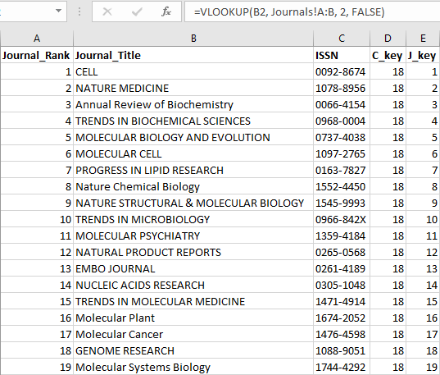
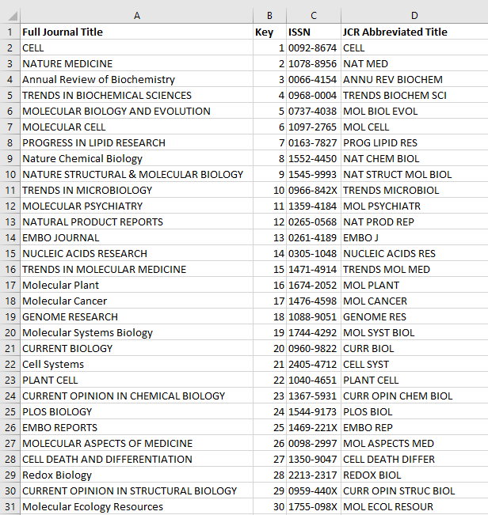
Formatting the Journals Table
Remove Category and Rank columns from Journals sheet, then remove duplicated journals
Add an auto-numbered “Key” column to Journals and import journal keys into Junctions sheet based on Journal name
1. Auto-numbered keys on Journals table
2. Journal keys imported to Junction sheet
Notes:
For the Journals table, add a key column and populate it with sequential, non-repeating numbers starting at 1
In the Junction table, add a column called “J_Key” and import that category’s key value based on the Journal_Title column. This can be done with an Index-Match or a VLOOKUP.

Slide 19




Notes on Analyzing/Summarizing JCR Data
In the Categories sheet, some fields use ">10.0" for values outside the range.
Replace these values with 11.0
In the Journals sheet, some fields use "Not Available", which must be removed for analysis
Delete these values and leave the cell blank.
Notes:
Just a few notes on making the data usable if you plan to summarize it for anything more than an exploratory summary.

Slide 20
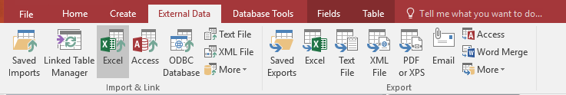
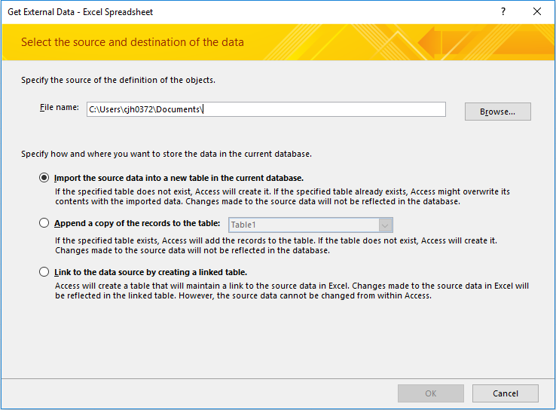
Creating Database Tables
Create a new, blank database in Access for your JCR content.
Under “External Data” in the ribbon, select “Excel”
In the first window, click “Browse”, navigate to the folder your JCR workbooks are save in, and open your combined categories workbook.
The rest of the defaults for importing the Excel sheet into a table are fine.
Notes:
This is just a quick overview of the procedure for importing these Excel sheets into Access

Slide 21
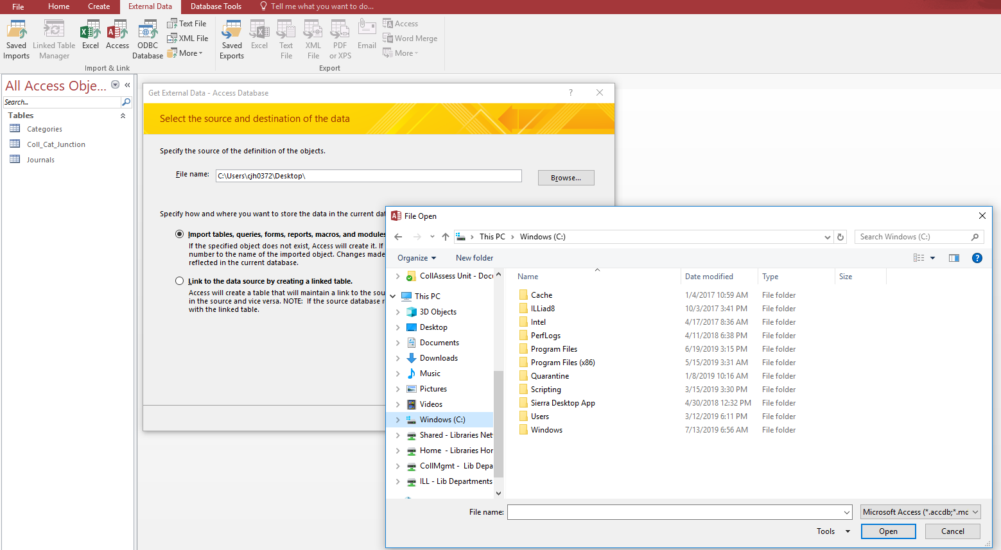
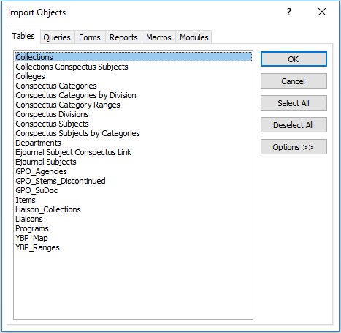
Importing Ejournals List
In the “External Data” ribbon, select “Access”
Open the database where you store your e-journals holdings
Import the table(s) where you store your holdings, including their eISSN/pISSN identifiers.
Notes:
Note that we use Serials Solutions and other libraries may use different services. Be sure to highlight the required fields.
*NOTE: This slide is for importing the e-journals/e-reference holdings, the table just happens to be called "Collections". The same process applies.

Slide 22
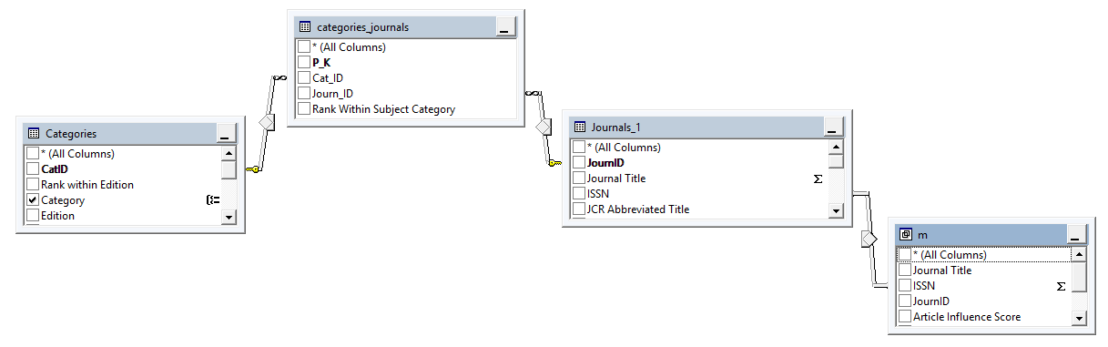
Queries to match
For querying this new JCR database, you’ll want to select from the Journals table as your base table, then join to
The Categories/Journals junction table on the J_Key identifier
The Categories table from the junction table on the C_Key identifier
The Holdings table by using an OR to join based on the holdings
Ex. INNER JOIN on ISSN = holdings.eISSN UNION
INNER JOIN on ISSN = holdings.pISSN WHERE holdings.eISSN <> holdings.pISSN
1. The base da
Notes:
For designing queries on this database, this is the general structure that you’ll want to use.
You start on Journals, and join to your junction table across the J_Key as your key value.
From there, you’ll use the C_Key on the junction table to join across to the Categories table, and now your whole JCR setup is complete. Now the only thing left to do is connect your local holdings.
For your holdings, your various journals may have either regular ISSNs or eISSNs, which we have as p/eISSNs in our databases. I won’t get too deeply into how to make that link here, aside to say that it can be done with either
Match on eISSN OR match on pISSN. This method can result on slightly slower query runtimes, but is simpler and easier to construct.
Or
A match on one ISSN type unioned with a match on the other for records where the two aren’t equal. This method is faster, but more complex.

Slide 23
Excel Features & Functions Used
Formatting as Tables
ease in labeling & referencing
VLOOKUP()
to match with Ejournals list
If() & ISERROR()
to label matched titles
If() & OR()
to identify all titles that matched
Pivot table
to summarize total by category
Notes:
No Access? Better at Excel? Yes, you can do this in Excel. Here are some of the features of functions that make this possible. We don’t have time to go into the details of how to use these, so if you get lost, that’s OK – there are plenty of videos out there to provide instruction. Here, we’ll show you how to apply them for our purposes.
Formatting as Tables helps with referencing columns and cells – rather than referring to B12, you can refer to ISSN column. VLOOKUP() has now become fairly standard among data-oriented librarians – who here has used VLOOKUP? Combining the IF() function with ISERROR and with OR enables you to easily identify the titles that matched using VLOOKUP. Finally, using pivot tables is an easy way to get those overlap percentages.

Slide 24
Excel Structure & Format
2 tables:
Ejnls
Your holdings list
ISSN and/or eISSN
JCR
Either altogether or
…each category separate
JCR_All
JCR_Math
VLOOKUP()
Notes:
When you start in Excel, you need all the data in one Excel file, preferably on separate worksheets. On each worksheet, format your data as tables. Naming the tables is important for following along – if you name them the same, the formulas we provide can be easily copied & pasted. We start with a minimum of 2 tables – one of your own ejournals, tabled named Ejnls. This must include the title and at least the ISSN field. If there is an eISSN field, this will help in matching. Then there are the JCR titles. It’s easiest if you merge the lists by category into one table, adding a column for the category. But you could but each list in a separate table, if you’d like.

Slide 25
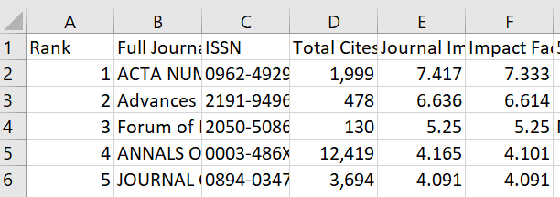
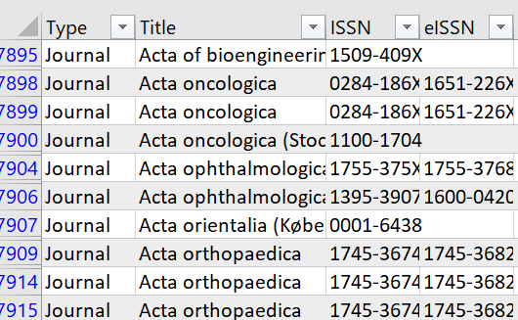
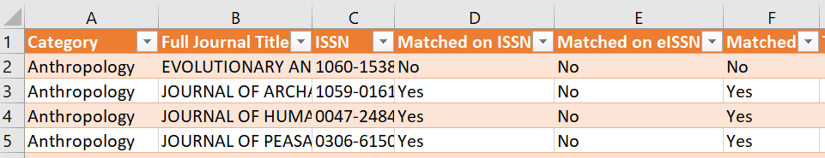
Starting point
JCR Journals
Own ejournals
Table name: JCR_Math
Table name: JCR_All
Table name: Ejnls
Notes:
Here’s how it would look – first is the JCR journals, here as one category and ^here, all journals together, with the category column added. Then there is the Ejnls table.

Slide 26
Matching steps
In the JCR table(s), add 3 columns:
Matched on ISSN
Matched on eISSN
Matched
Notes:
In the JCR tables, add these 3 columns.

Slide 27
Matching Formulae
Use these formulae for the respective columns:
Matched on ISSN:
=IF(ISERROR(VLOOKUP([@ISSN],Ejnls[ISSN],1,FALSE)),"No","Yes")
Matched on eISSN:
=IF(ISERROR(VLOOKUP([@ISSN],Ejnls[eISSN],1,FALSE)),"No","Yes")
Matched:
=IF(OR([@[Matched with Ejnls on ISSN]]="Yes",[@[Matched on eISSN]]="Yes"),"Yes","No")
Notes:
Then for each column, use these respective formulae – Notice how the If() combined with ISERROR helps identify the matched titles easily. Then the IF combined with OR identifies titles that matched with either ISSN or eISSN.

Slide 28
Summarize by Category
If all JCR lists in one worksheet…
If each category is a worksheet…
Insert a pivot table
Rows: Category
Columns: Matched
Values: COUNT(Title)
Count Matches
Check: Total Row
Scroll to bottom of table
In the Total cell for the Matched column, use this formula: =COUNTIF([Matched],"Yes")
Table ribbon -> Design tab
Notes:
If you combined all of the JCR journals by category in a single table, you can use pivot tables to quickly summarize overlap rates by category. If you use one table per category, you can use the Total Row feature to count the number where Matched is “Yes”

Slide 29
Demo in Excel
Table name: JCR_All
Notes:
So, here we go…we start with the JCR list of journals – here we’ve added the 3 “Matched” columns and inserted the formulae.

Slide 30
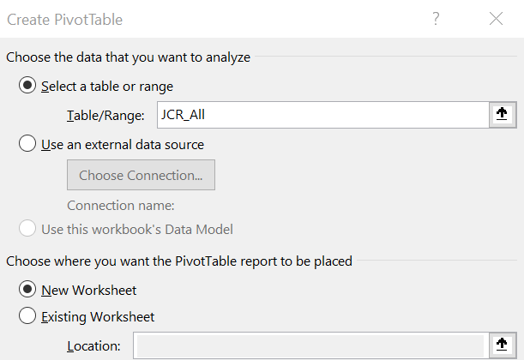
Demo in Excel
Notes:
Then we start the pivot

Slide 31
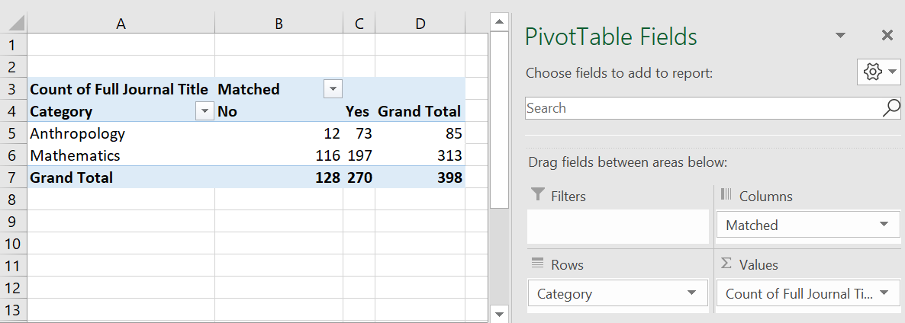
Demo in Excel
Table name: JCR_All
Notes:
Putting ^category in Rows
^Matched in columns
^Count of titles in Values
But this just gives us the # of titles…to get overlap %...

Slide 32
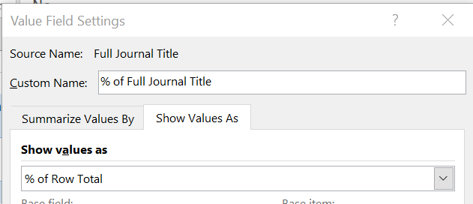
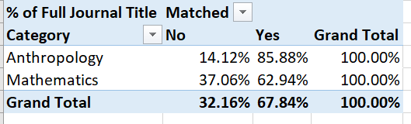
Demo in Excel
Notes:
Show the summary value as % of Row and
^voila – Overlap rate of 86% for Anthropology, but only 63% for Math!

Slide 33
Limitations
Going to be errors/mismatches
Review lists carefully
Notes:
Now, some warnings – the JCR titles are not very clean – there will be some errors in ISSNs and, more commonly, journal titles. Review the lists carefully to find those errors.

Slide 34
Extensions
% of top x% by metric
Map the subject categories to subject-based collections
Notes:
After you’ve gotten the basic overlap rates, you could then add calculations for determining the overlap of the top, say, 75% of the journals. You could also create a separate list, de-dupe the titles, and get an overall overlap rate.
Finally, you could map the subject categories to broader subject-based collections – like all the biological sciences categories to Biology.

Slide 35
Appendix – https://github.com/unt-libraries/JCR
Design notes
Detailed ERM’s
More queries
Notes:
We have examples of the queries, detailed data diagrams – all linked in GitHub.

